Slide 1
SAL 605 Final Project
MLB 2026 ABS Challenge System
Strategic Impact, RE24 Valuation, and Interactive Dashboard Analysis
By Avery Hamel

Slide 2
PROJECT OVERVIEW
The start of the ABS challenge era
Evaluating decision-making, run expectancy, and leverage in Major League Baseball through ABS challenges
Core Motivation
Data Pipeline
Key Takeaway
Resource allocation
Data source
Leverage dominance
MLB's automated ball-strike (ABS) challenge system introduces a strategic resource allocation challenge, requiring teams to optimize limited challenges across games while mostly prioritizing high-leverage plate appearances.
Analyzes 10,557 executed challenges, 16,589 missed opportunities, and 1,658 out-of-challenge events from the 2026 MLB season (courtesy of TapToChallenge.com).
The Leverage Index (LI) for a call is the primary scalar of run value swings, showing the value of a given challenge in terms of leverage. Missed opportunities and situations where teams run out of challenges create measurable run-expectancy penalties for teams.

Slide 3
METHODOLOGY
Research questions & analytics pipeline
Structuring the data to study my chosen questions
Research questions
Methodological framework
•
RE24 impact: How do ABS challenge outcomes alter run expectancy and game leverage (LI Call)?
•
State categorization: Segmenting plays into Executed Challenges, Missed Opportunities, and Out of Challenges. I also sought to categorize challenges on whether they were initiated by a batter or a pitcher/catcher.
•
Opportunity cost: What is the run cost of leaving challenges on the table (missed opportunities)?
•
Depletion penalty: What is the cost when teams are out of challenges in high-leverage spots or during an AB that could have been challenged?
•
Econometric models: OLS Regression of RE impact (Model 1) and a logit GML model of challenge success probability(Model 2).
•
Simulation: Monte Carlo stochastic modeling across 1,000 iterations to project variance.

Slide 4
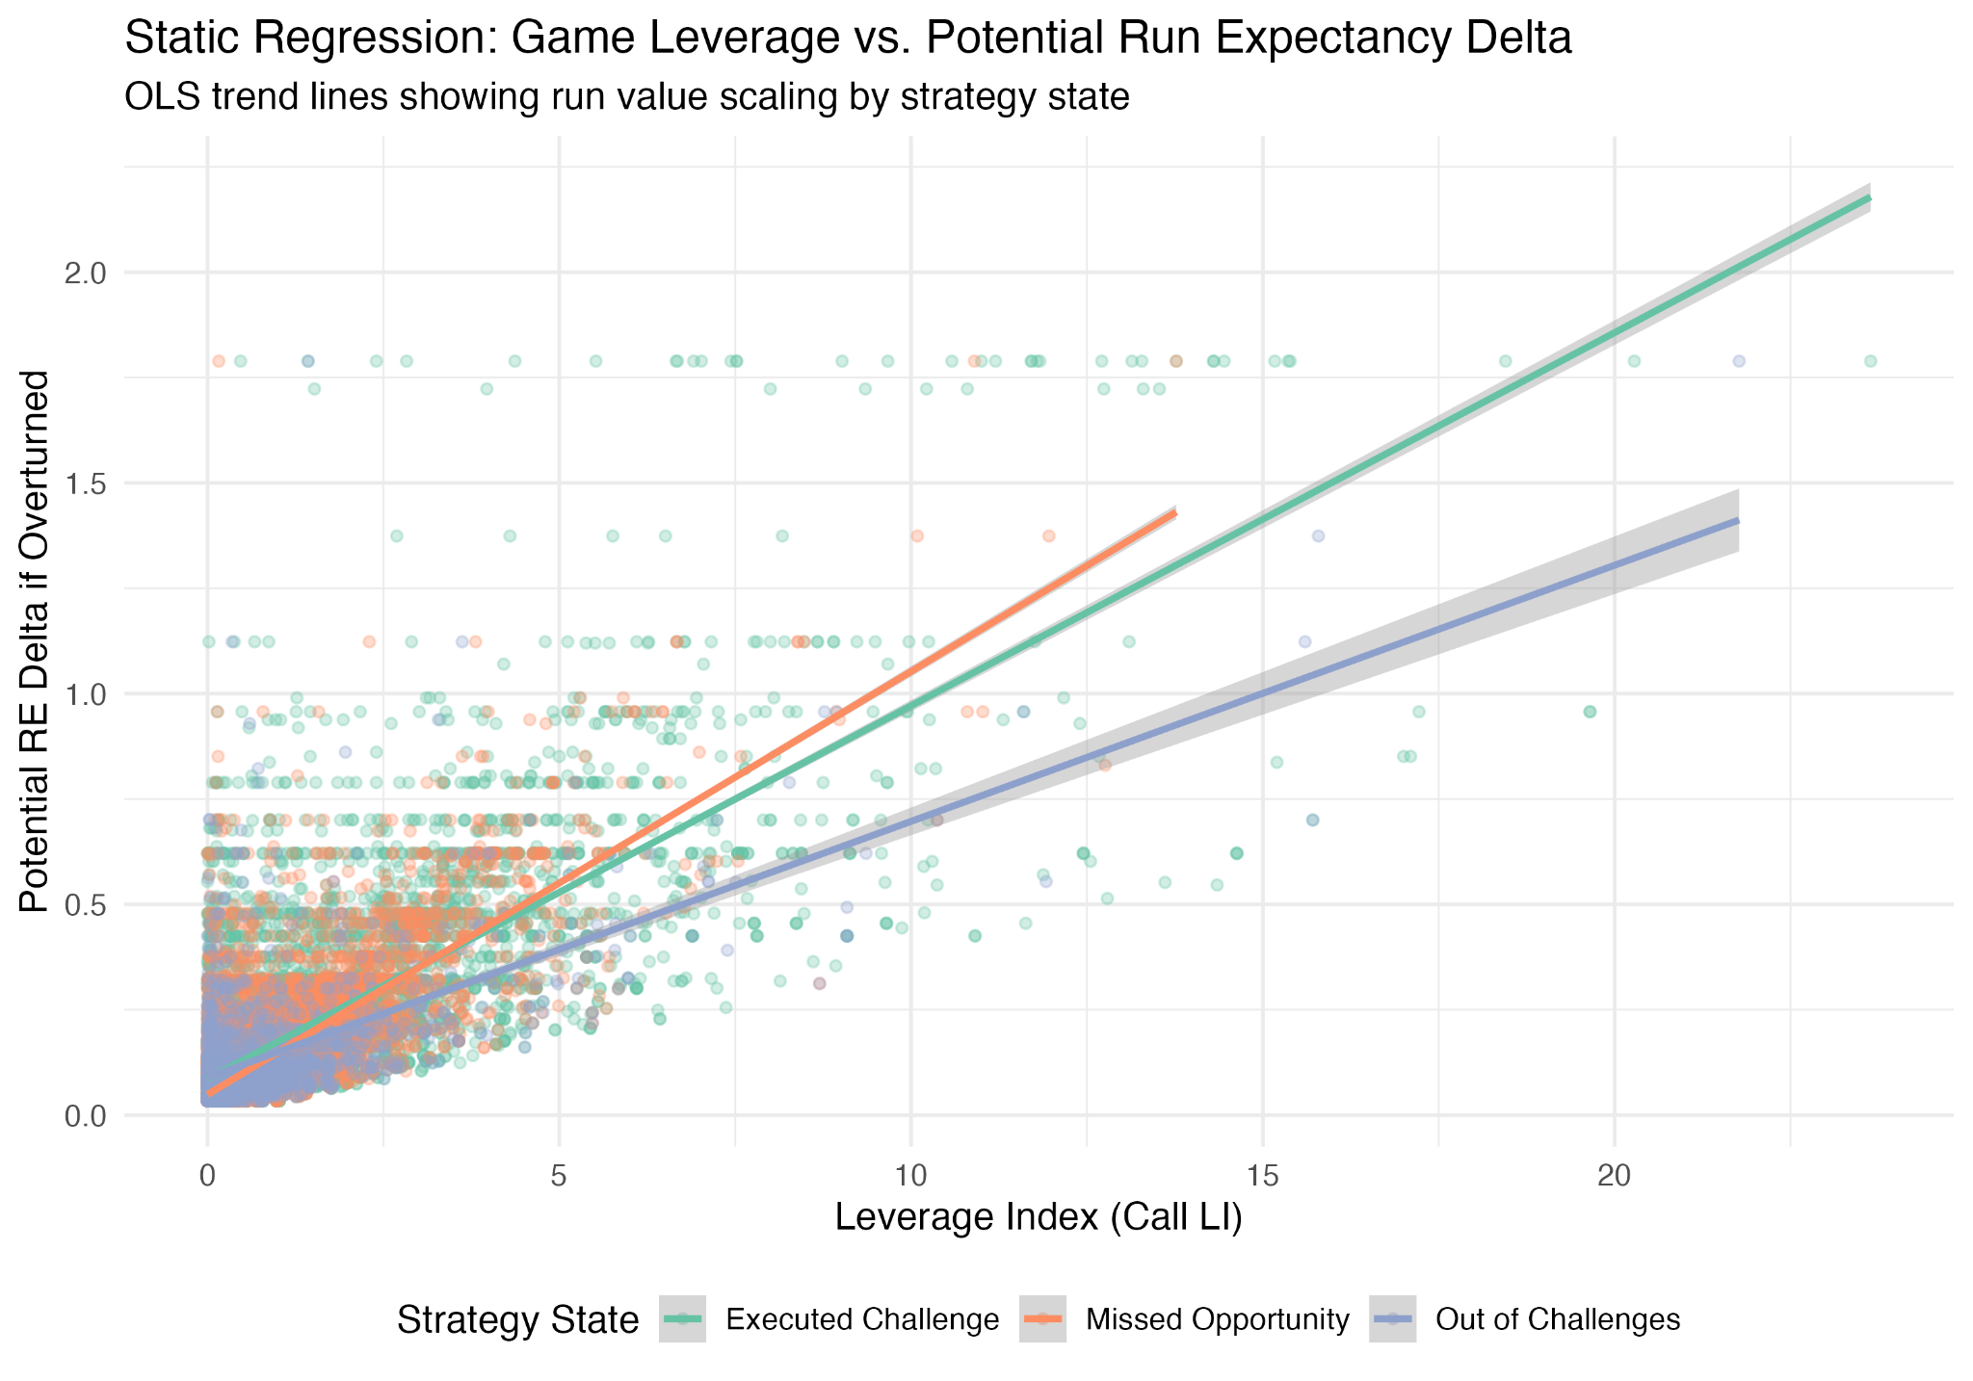
ECONOMETRIC MODELING
Model 1: Run Expectancy impact (OLS regression)
Formula: Potential Run expectancy change if overturned ~ Category type (executed challenges, missed opportunity, out of challenges) + Call LI
(N = 28,803)
Model fit & statistical significance
Adjusted R-squared: 0.562
Over 56% of the variance in potential run expectancy change is explained by game leverage and decision states.
F-statistic: 1.232e+04
p-value: < 2.2e-16
Key coefficient takeaways
•
Intercept (0.0853): Baseline expected run change for executed challenges at zero leverage.
•
Missed opportunity (-0.0285): Missed opportunities average 0.028 fewer runs in potential swing value.
•
Out of challenges (-0.0219): Depleted states average 0.022 fewer runs in baseline potential swing.
•
Call LI (+0.0888, p < 2e-16): For every 1-unit increase in Leverage Index, potential RE change increases by nearly 0.09 runs. Leverage is the dominant scalar.

Slide 5
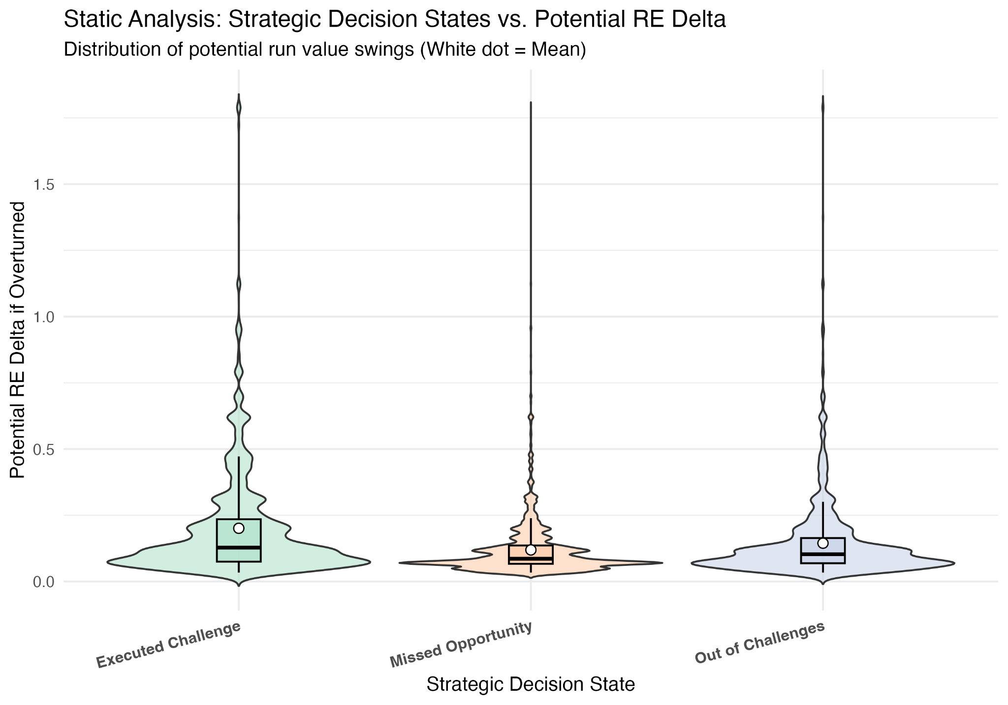
ECONOMETRIC MODELING
Model 2: Challenge success probability (logistic GLM)
Formula: Result (True/False) ~ Dist (in.) + xStr% + Call LI (N = 10,556)
Model fit & diagnostics
Method: Binomial logistic regression (logit link)
Coefficient interpretations
•
Distance from zone (-0.161, p < 0.001): As a pitch gets further from the strike zone, overturn success odds decrease. Teams challenge borderline edge calls most frequently.
•
Expected Strike % (+0.995, p < 0.001): Higher expected strike probability strongly predicts successful overturns.
•
Call LI (-0.107, p < 0.001): In high leverage situations, executed challenges have slightly lower overturn success, reflecting the strategy but also the weight of high-pressure challenges.
Visualization: While overall distributions cluster near zero, executed challenges exhibit broader upward dispersion in high-leverage plate appearances.

Slide 6
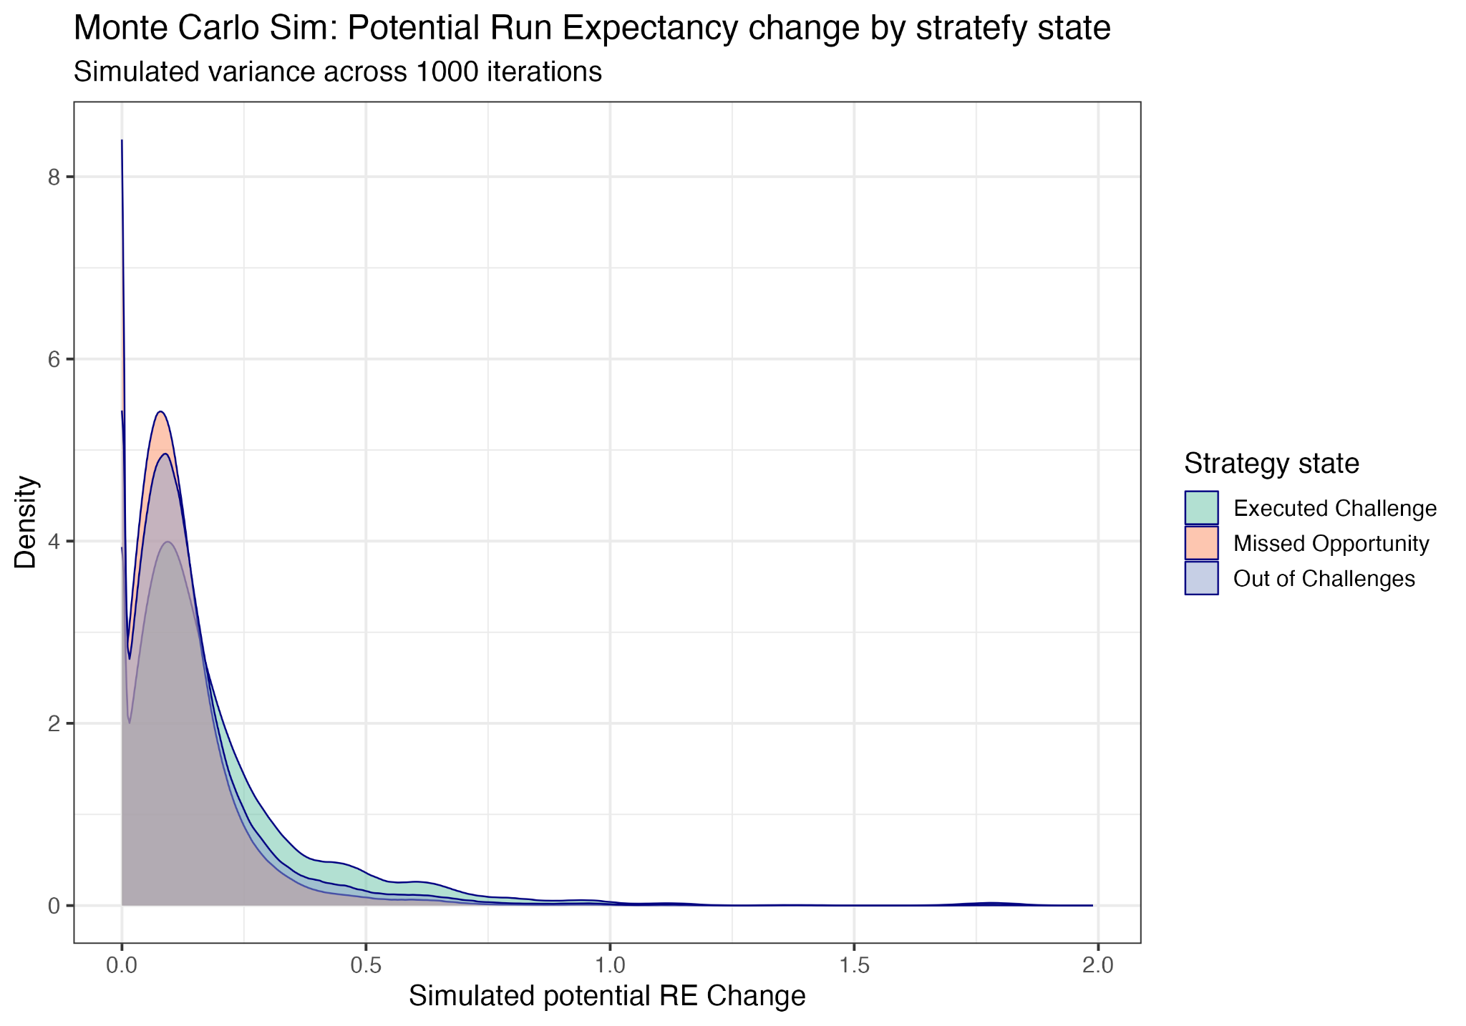
EMPIRICAL VISUALIZATION 3
Monte Carlo simulation: Run Expectancy variance
Simulated probability density curves across 100 iterations, so the Shiny app doesn’t crash
Visualization insight
Capturing game-state uncertainty, this Monte Carlo simulation density plot models stochastic variance in potential run expectancy changes across 1,000 iterations.
The overlapping density curves illustrate consistent risk profiles and restricted potential value across executed challenges, missed opportunities, and no challenge states.

Slide 7
INTERACTIVE SOFTWARE
R Shiny dashboard architecture
Shiny app access
Team and player filters allow users to explore deeper into the player-season and team-season-level data
User Interface & reactivity
Dashboard tabs & outputs
•
Team & Player selectors: Dropdown menus allowing users to toggle between league-wide views, specific franchises, or individual players.
•
Strategy comparison panel: Dynamic violin plots and box plots with selectors to explore across challenge states.
•
Leverage vs. RE trend: Interactive OLS trend analysis with confidence intervals to visualize Model 1.
•
Metric selection: Dynamic switching between Potential RE Delta, Leverage Index (Call LI), and Zone Distance for the violin plot.
•
Monte Carlo Simulation Tab: Live density spread visualization to explain the simulation results.
Visualizations: Included visualizations to explain both models and the Monte Carlo simulations, along with a team-based bar plot and strategy data table.
•
Strategy data table: A dynamic and context-aware summary table that adapts from league-wide team leaderboards to player rosters, sorted by leverage.

Slide 8
CONCLUSIONS
ABS strategic takeaways
What do these models, simulations, and visualizations tell us about ABS in its first MLB season?
Priority 01
Priority 02
Priority 03
Leverage is king
Resource depletion
Dashboard value
Teams must preserve challenges for high-leverage index (Call LI) situations. Run-value costs scale rapidly with game pressure and leverage situations.
Being out of challenges carries a measurable run expectancy penalty, leaving teams vulnerable to late-inning blown calls. This re-emphasizes the importance of conserving challenges when possible, making decision making even more difficult.
The interactive R Shiny application bridges our advanced modeling and simulation with practical baseball operations strategy and an interactive, visual explanatory platform.

